Slide 1
Analyse International Debt Statistics
BI Project Report

Slide 2
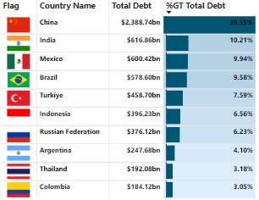
Objective :
Creating interactive report by using World Bank’s Data to visualize and analyse the debt owed by the developing and financially unstable countries and economies.

Slide 3
Tasks of the BI Report :
Summarising World Bank's international debt data.
Finding the number of distinct countries.
Finding out the distinct debt indicators.
Totalling the amount of debt owed by the countries.
Country with the highest debt.
Average amount of debt across indicators.
The highest amounts of principal repayments.
The most common debt indicator.
Other viable debt issues and conclusion.

Slide 4
Data Info:
File Name (IDS_ALLCountries.xlsx)
Number of Sheets (4)
Length of date stamp (8 Digits)
Number of Columns (6 Columns)
Column Names
Country Name
Country Code
Indicator Name
Indicator Code
Years
Debt
Columns Data Type ( Characters)

Slide 5
Process of Creating Report
Preparing Data
Downloaded data from https://datacatalog.worldbank.org/dataset/international-debt-statistics
Imported in Python.
MySQL Database
Answered for Problem questions using SQL queries.
Connected MySQL to Power BI Directly for Dashboarding.
Saving Report
Publishing and Saving the report in BI Service and Desktop.
Using pandas performed Data Cleaning.
Power BI Dashboard
Connected directly to the MySQL database to create visual representations of the data and analysis results.

Slide 6
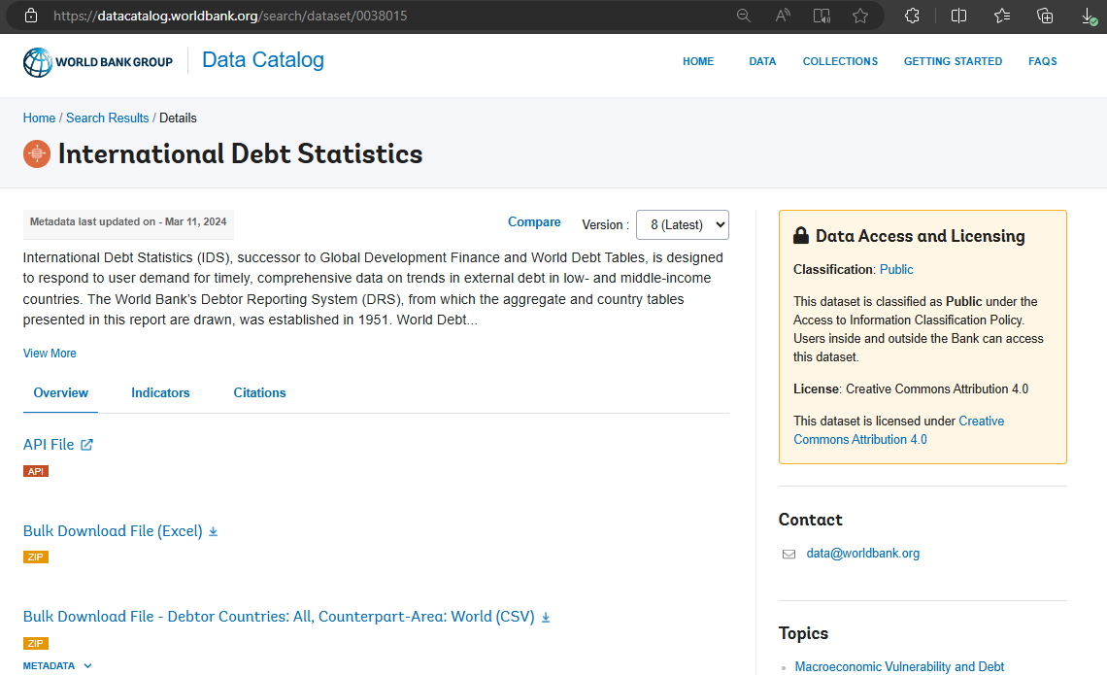

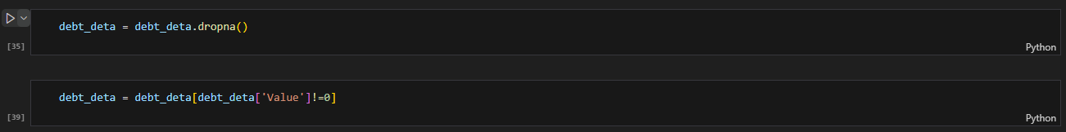
Preparing Data
First and second step, is to download the data and import it to the Python for Data Cleaning and transformation.

Slide 7
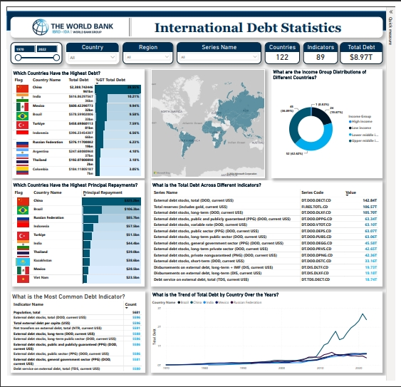
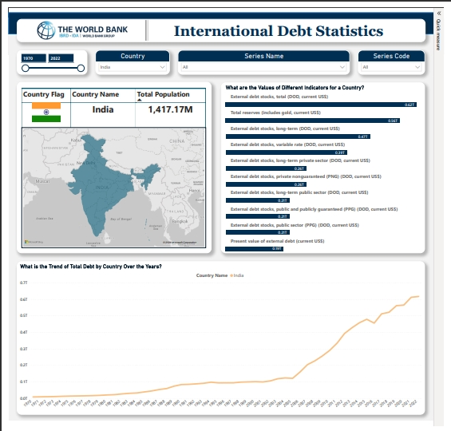
Creating BI Report
Creating Visuals using Matrix, Cards, Maps and etc,.
Filtering out some of the rows containing group of countries or Organisations.
Top N Filters are used for filtering top countries with respect to the required tables.

Slide 8
CONCLUSION
High Debt Concentration: China and India are the leading countries in terms of total debt, with China holding nearly 40% of the global debt.
Significant Repayments: China also has the highest principal repayments, indicating its large debt servicing obligations.
Debt Trends: There has been a significant rise in total debt since the 2000s, with notable increases during economic crises.
Income Group Distribution: Upper-middle-income countries hold the majority of the debt, highlighting economic disparities.
Recommendations
Policy Focus: Countries with high debt and repayments should focus on sustainable debt management strategies.
Economic Diversification: High-debt countries might benefit from diversifying their economies to reduce dependency on debt.
Further Analysis: Additional analysis on the impact of debt on economic growth and development could provide deeper insights.

